Slide 1
EcoStruxure Transformer Expert
Digital transformation of transformers with IoT sensors and expert analysis
Security Overview

Slide 2
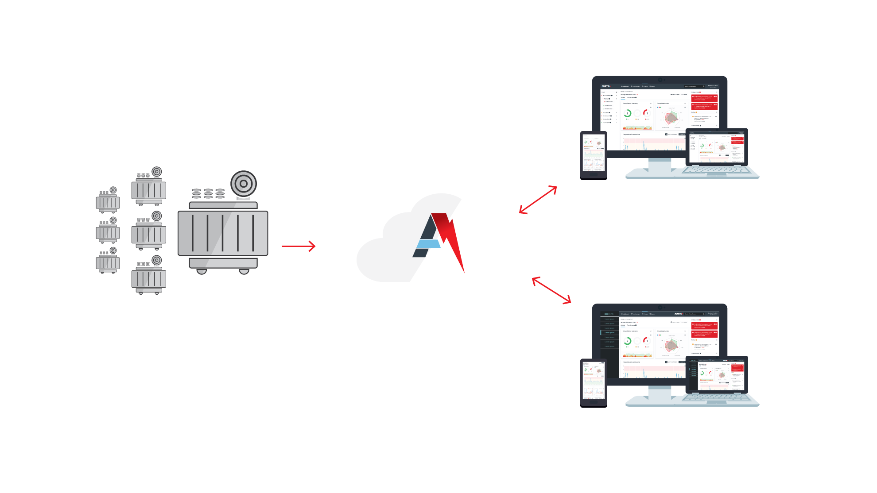
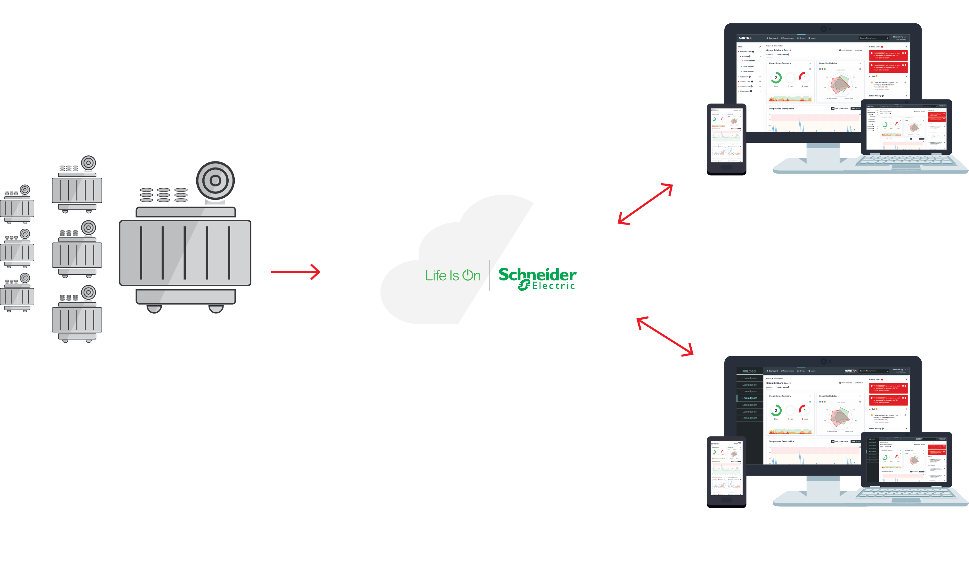
EcoStruxure Transformer Expert Solution Architecture
Fleetwide
dashboard
Fleetwide intelligent IoT sensors
Expert analysis
Embedded expert system in 3rd party solutions

Slide 3
IT Security Overview
Schneider Electric has designed the IOT data transfer process, storage, access and management operations to be compliant with the EU power utility data security requirements.
EcoStruxure Transformer Expert Architecture: Novel file format ensures data cannot be interpreted. In the unlikely case it is intercepted, data is verified and encrypted multiple times as it moves through our cloud and pipeline.
IoT Architecture: Ensures customers can be automatically upgraded with security system updates as part of their Subscription Agreement. No customer involvement needed to be up to date with security enhancements.
Use of AWS: The AWS hosted architecture ensures system reliability and security are in line with industry standards.
No Transformer Control: There is no access to SCADA or transformer control through the communications or software actions of the solution. The solution monitors and analyses the transformer only.

Slide 4
IT Security Overview
EcoStruxure Transformer Expert security architecture protects customer data using four key features.
Remote Sensor Security
Network Connection Security
Data Transfer & Backend Security
User Data & Dashboard Security

Slide 5
Remote Sensor Security
Data contains no local information or direct load information
No direct sensor-to-customer network interface
No backdoor access to the customer’s network
All data is transferred over the 3G/4G network
Files are stored in a Linux operating system
Linux protection processes safeguards the files against any data damage

Slide 6
Network Connection Security
Sensor data upload is conducted at a different, random time with a new IP address each day
The 3G/4G interface is on-line for less than 2 minutes per day for uploading data
The 3G/4G interface is powered down when not uploading
Before transmission data is encrypted with AES-256 using Key Derivation Function algorithm
Data can only be decrypted if it is undamaged
Encryption checksum process restricts even a part file from being decrypted correctly
Damage of even 1 byte would result in a complete scramming of the output

Slide 7
Data Transfer and Back-End Security
EcoStruxure Transformer Expert uses a novel data upload format
The sensor connects to a dedicated clearing site
No direct access from the sensor to the back-end processing server
Data integrity of upload is checked prior to ingestion and stored in a AES-256 encrypted database
Raw data from the sensors is stored in a separate data base which contains no identifiable information
There is no link from the data to a transformer/customer without access to the other databases

Slide 8
User Data & Dashboard Website Security
Use of encrypted upload from the back-end processing service to the user-accessible website
Secure password and HTTPS encrypted access for users
Benchmark password security including password hardness management
User interface only holds and displays processed plot-based data and outputs i.e. no raw data
User interface has no system-stored linkage between data and a user site (unless entered at the user’s discretion)

Slide 9
API Security
EcoStruxure Transformer Expert provides a REST-based API that returns structured JSON data. API keys, generated by an organisation's user admin on demand, protect data from unauthorized access.
Secure ETE databases
Customer Asset Management or 3rd party solutions
Secure API Interface

