Slide 1
EcoStruxure Transformer Expert
Graphical representation of DGA results through the ETE package
Presented by: Presenter’s Name

Slide 2
Contents
1
ETE Cross Correlation Model
Correlation Model
2
Oil Test Data Output IEC Standards
Roger Gas Limit & Ratio Analysis
Doernenburg Gas Limit & Ratio Analysis
IEC Ratio Analysis
Duval Triangle/Pentagon Methods
3
ETE Oil Analysis
4
References

Slide 3
EcoStruxure Transformer Expert
ETE Oil Analysis & ETE Cross Correlation Model

Slide 4
Schneider Electric: EcoStruxure Transformer Expert
How to monitor your transformers risks
Continue to perform oil sampling and testing.
Install innovative sensors to record data online.
ETE analyses and correlates data in a single view to anticipate irreversible trends.

Slide 5
ETE Oil Analysis & Insight Interaction Architecture
An ETE software model that enhances the data platform available for ETE Insight analysis
Objective
A low cost central repository for oil test data
Make use of all readily available data to drive better analysis of Tx status
All data mapped against well accepted International standards
Deliver a single site for oil test data collection
Provides easy access to oil test data via unlimited cloud based access for corporate users
Secure password protected data
Easy & automated upload process using oil test laboratory format (.csv file)

Slide 6
Offline Oil Test Data Model
Oil Test Data .csv file
ETE Oil Test Data Model
ETE Cloud Processing
Doernenburg Ratio Analysis
Roger Ratio Analysis
IEC Ratio Analysis
Duval Triangle 1, 4 & 5
Duval Pentagon 1 & 2
Interfacial Tension
DP by Furans
Dielectric Strength
Moisture in Oil
Acidity in Oil
Doernenburg Gas Analysis
Roger Gas Analysis
Oil Gas Level Indicators
IEC Oil Analysis
Fault Indicators

Slide 7
Oil Test Data & ETE Insights Cross Correlation Model
ETE Temp, Moisture, DP, Vibration, PD Models
Oil Test Data Model
ETE Insights Model
International Standards

Slide 8
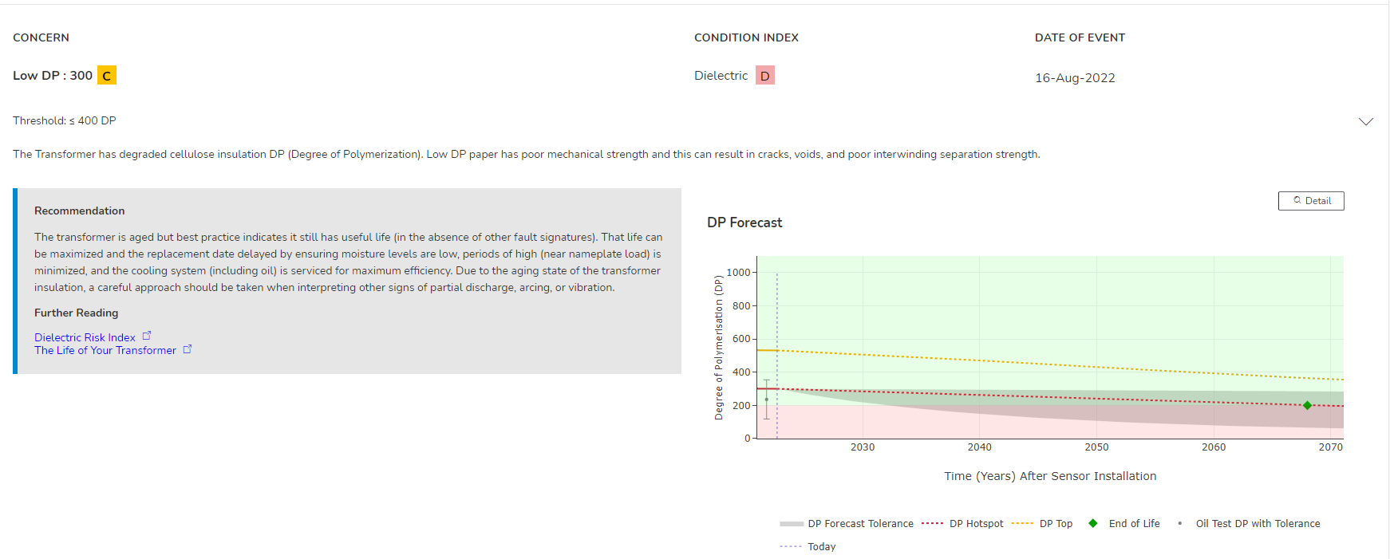
Oil Test Data & ETE Insights Cross Correlation Model
Below is an example of how ETE provides comprehensive insights and recommendations to avoid transformer failure.

Slide 9
EcoStruxure Transformer Expert
Oil Test Data Output - International Standards

Slide 10
Roger Gas Limit Analysis
The ETE platform generated graph from the concentration of H₂, Methane, Ethane, Ethylene, Acetylene and CO in each oil test.
Only applicable if at least one of the gases is at a concentration above the benchmark value.
If there are no gases meeting this requirement, the analysis is not applicable.
The background grey bars show the benchmark value of each gas.

Slide 11
Roger Ratio Analysis
Using Roger Ratio Analysis, ETE provides insights into potential faults in the transformer.
The severity of the fault is represented by colour.
If the required threshold is not met for the analysis, the results will be shown as a thin green line.
Please note these graphs provide an analysis using IEC & IEE standards. The limitations described in the relevant standards apply.

Slide 12
Doernenburg Gas Limit Analysis
The ETE platform generated graph from the concentration of H₂, Methane, Ethane, Ethylene, Acetylene and CO in each oil test.
Applicable regardless of gas concentration level.
If a gas concentration is under the benchmark value, it is diagnosed as ‘normal’.
The background grey bars show the benchmark value of each gas.

Slide 13
Doernenburg Ratio Analysis
Using Doernenburg Ratio Analysis, ETE provides an indication of potential faults in the transformer.
The severity of the fault is represented by colour.
If the required threshold is not met for the analysis, the results will be shown as a thin green line.
Please note these graphs provide an analysis using IEC & IEE standards. The limitations described in the relevant standards apply.

Slide 14
IEC Ratio Analysis
The ETE platform uses the three commonly analysed gas ratios of C₂H₂/C₂H₄, CH₄/H₂ and C₂H₄/C₂H₆ to plot this graph.
The severity of the fault is represented by colour.
If the required threshold is not met for the analysis, the results will be shown as a thin green line.
Please note these graphs provide an analysis using IEC & IEE standards. The limitations described in the relevant standards apply.

Slide 15
Duval Triangle Method
The ETE platform provides a range of graphical representations to support the interpretation of DGA results, including the Duval Triangle method, which assists in diagnosing faults.
Based on three key gases of CH₄, C₂H₄ and C₂H₂.
Gas concentrations are calculated and then plotted along each side of the triangle.
The triangle is subdivided into fault zones. The fault zone in which the point is located indicates the likely fault diagnosis.
Should only be used in conjunction with other tests as this method cannot identify a normal condition (i.e., no fault).

Slide 16
Duval Triangle Method
Duval Triangle 4 & 5 are used in the same manner, assisting customers in obtaining more detailed information about sub-types of thermal faults.

Slide 17
Duval Pentagon Method
This method is another graphical representation to support the interpretation of DGA results.
Uses all five hydrocarbon gases H₂, C₂H₆, CH₄, C₂H₄ and C₂H₂.
Six basic types of fault can be detected.
Should only be used in conjunction with other tests as this method cannot identify a normal condition (i.e., no fault).
Duval Pentagon 2 can be used to obtain more information on thermal faults.

Slide 18
EcoStruxure Transformer Expert
ETE Oil Analysis

Slide 19
Oil Quality Graphs
ETE uses oil quality test results imported by the customer to create five types of graphs.
Interfacial Tension
Dielectric Strength
Acidity in Oil
Depolymerization by Furans
Moisture in Oil

Slide 20
Interfacial Tension
The interfacial tension is a measure of the molecular attractive force between the oil and water molecules. A Low IFT can be a result of contaminants and by-products in the oil.

Slide 21
Dielectric Strength
This plot tracks the dielectric breakdown voltage of the oil. The dielectric strength of oil is generally reduced by the presence of contaminants in the oil.

Slide 22
Acidity in Oil
The presence of acidity in the oil is a threat to the transformer, causing it to age faster. It can also indicate the formation of sludge which can impede oil flow and affect efficient cooling.

Slide 23
Depolymerization (DP) by Furans
One method of determining the DP of the transformer’s solid insulation is by measuring the level of furans in the oil. This graph uses the Chendong model to calculate DP and plot it over each furan reading.

Slide 24
DP History
Using mathematical algorithms and oil test history, ETE can plot the estimated aging profile of the paper insulation. This graph gives insight into the rate of aging of the insulation since the beginning of its service to its current DP.

Slide 25
DP History
The error bars shows on the chart shows DP from furan using Chendong equation. The red square shows DP best estimate. It is derived from weighted average of historical aging DP with Oil Test DP with tolerance, representing the best estimate DP at the time of ETE installation.

Slide 26
Moisture in Oil
This graph plots the amount of water detected in each oil test conducted by the customer. Moisture moves between the oil and paper insulation as the temperature fluctuates in the transformer. Therefore, this result is very sensitive to the temperature of the oil when it was sampled.

Slide 27
Water Content of Oil
This graph shows WCO measured by the ETE sensor. Red points indicate the moisture measured during oil testing. The ETE sensor records moisture data every hour. It can be clearly seen how much additional data the ETE sensor can provide.

Slide 28
Water Content of Oil
Here is another example from a different transformer. Two red points demonstrate that the moisture measured during oil testing in 2019 & 2020 align with the ETE sensor.

Slide 29
References
To learn more about these graphs, visit the below links using your demo login:
Roger Gas Limit & Ratio Analysis https://learn.aurtra.net/hc/en-us/articles/360039716331-Rogers-Gas-Limit-Analysis
https://learn.aurtra.net/hc/en-us/articles/360039311152-IEEE-Rogers-Ratio-Analysis
Doernenburg Gas Limit & Ratio Analysis
https://learn.aurtra.net/hc/en-us/articles/360039714671-IEEE-Doernenburg-Gas-Limit-Analysis
https://learn.aurtra.net/hc/en-us/articles/360039714631-IEEE-Doernenburg-Ratio-Analysis
Duval Triangles & Pentagons https://learn.aurtra.net/hc/en-us/articles/360039311312-Duval-Triangle
Oil Quality https://learn.aurtra.net/hc/en-us/articles/4403551179289
DP History https://learn.aurtra.net/hc/en-us/articles/360038865592-Top-Paper-DP-History

